Slide 1

AI-Driven Academic Risk & Dropout Early-Warning System Using Digital Twin
Digital Class Twin | Mini Project – Review 3
Team Members
Guide
Altrin Benser A
962223205010
Jerish Rethna J
962223205029
Er. Agnes Alex Rathy P M.E.,MBA
Assistant Professor / IT
John Jins J
962223205032
Mukhilan M
962223205040
Department of Information Technology
St. Xavier’s Catholic College of Engineering (Autonomous), Chunkankadai, Nagercoil
Notes:
Good morning respected members of the evaluation committee and our guide, Er. Agnes Alex Rathy ma'am. We are presenting the 3rd Review of our mini-project: AI-Driven Academic Risk & Dropout Early-Warning System Using Digital Twin. In Review 1 we outlined the concept and architecture, in Review 2 we showed the preliminary prototype. Today we present the complete, verified, end-to-end implementation: real-time event pipeline, hysteresis digital twin state transitions, explainable factor attribution, multi-stakeholder dashboards, in-memory What-If simulation and empirical performance benchmarks.

Slide 2
Abstract
Autonomous engineering institutions mandate at least 75% attendance and defined continuous internal assessment (CIA) cut-offs, yet early indicators of academic risk—such as irregular attendance, sudden test drops, and missed lab submissions—remain isolated across disparate faculty registers. Consequently, at-risk students are typically identified only during end-of-semester reviews when remediation is no longer viable, and conventional campus ERP systems display static historical metrics without explaining the underlying drivers of academic decline. To resolve this challenge, we developed Digital Class Twin, a proactive, event-driven early-warning platform that maintains an active, continuously synchronised digital replica of every student. Micro-events are ingested in real time via REST APIs into a rolling 30-day temporal engine that computes an explainable Composite Health Score (50% Academic, 30% Attendance, 20% Conduct) with transparent factor attribution. An anti-flicker state machine governed by ±2.0-point hysteresis classifies each student into Stable, Warning, or Critical bands while preventing alert oscillation. Furthermore, an in-memory What-If simulation sandbox enables faculty mentors to model hypothetical recovery interventions without modifying live records, backed by dedicated desktop and mobile portals for students, faculty mentors, parents, and academic administrators.
Notes:
The abstract in short: autonomous colleges require 75 percent attendance and CIA cut-offs, but early warning signals such as absenteeism, quiz drops and missed labs sit in separate registers, so students are caught only at term-end reviews. Our Digital Class Twin creates a living twin of every student from real-time events, with rolling 30-day features, an explainable 0 to 100 health score, a hysteresis state machine and an in-memory What-If simulator, delivered through desktop and mobile portals. Verified results: 26.12 ms ingestion, 38.30 events per second, 2.24 ms twin query and 0.48 ms What-If projection. The next slide covers the problem statement and the five objectives.

Slide 3
Problem Statement & Core Objectives
Problem Statement
Core Objectives
Reactive detection: students are flagged only at term-end condonation reviews.
Data silos: attendance, marks and conduct are never combined.
Black-box reports: ERPs show raw percentages, not the reason for a slide.
No prognosis: advisors cannot simulate recovery interventions.
Living Digital Twin
Real-time virtual profile updated on every classroom event
1
Explainable Risk Score
0–100 health score: 50% Academic, 30% Attendance, 20% Conduct
2
Anti-Flicker State Machine
Stable / Warning / Critical with hysteresis safeguards
3
What-If Simulation Sandbox
Mentors test interventions in memory, no record changes
4
Multi-Stakeholder Portals
Role-based desktop and mobile views for all four user roles
5

Slide 4
Literature Survey & Research Gap
Reference | Approach / Focus | Key Limitation | How Digital Class Twin Solves It
Alalawi et al. (2025) Educ. & Inf. Technol. | ML performance prediction with extended learning analytics | Batch processing; no live feedback to students or parents | Event-driven updates with sub-30 ms twin refresh
Katsuragi & Tanaka (2022) CSEDU 2022 | Interpretable ML model for dropout prediction | Offline post-hoc model; no intervention sandbox | Explainable attribution plus What-If simulator
Tiukhova et al. (2024) J. Learning Analytics | Stability of explainable AI in education | Algorithm-only; no full-stack twin replica | Living twin tracking rolling 30-day shifts
Grieves & Vickers (2017) Springer Cham | Foundational Digital Twin framework | Applied only to industrial / mechanical systems | Brings the twin paradigm to academic monitoring
Plak et al. (2022) Assess. & Eval. High. Educ. | Early-warning systems for student counselling | Periodic batch surveys; no daily event telemetry | Daily micro-event ingestion (attendance, labs)
Research Gap Identified
Continuous synchronization
Existing models use retrospective semester datasets, not live event streams.
The black-box usability gap
Prior work outputs raw probabilities with no factor attribution advisors can use.
In-memory prognosis
No campus platform lets mentors test what-if recovery targets before guidance.
Notes:
We compared five key works. Alalawi et al. use batch processing with no live feedback; Katsuragi and Tanaka give an offline interpretable model without an intervention sandbox; Tiukhova et al. focus on explainable AI stability only; Grieves and Vickers define digital twins for industrial systems; Plak et al. rely on periodic surveys. This leaves three gaps: no continuous synchronization, no explainable factor attribution for advisors, and no in-memory what-if prognosis. Digital Class Twin fills all three.

Slide 5
System Design, Architecture & Methodology
System Architecture
Design Methodology
Classroom Event Ingestion
Event-driven: events arrive via POST /events, are validated with Pydantic and processed at once.
Rolling 30-day window: captures recent deterioration, not cumulative totals.
Hysteresis guard: a ±2.0 point buffer stops alerts flickering near cut-offs.
Non-destructive What-If: shadow twin copies run in memory, with no database writes.
Attendance swipe / register
CIA / quiz / assignment marks
Conduct, merit & disciplinary flags
FastAPI Core Pipeline (event-driven)
REST ingestion /events
Schema validation
30-day feature engine
Risk engine (0–100)
Hysteresis state machine
Persistence & Alerts
Composite Health Score
H = 0.50·A + 0.30·C + 0.20·B
A: CIA average C: 30-day attendance B: conduct. Risk R = 100 − H
Audit snapshot engine
Mentor alert engine
SQLAlchemy DB (SQLite / PostgreSQL)
Multi-Stakeholder Portals (React 18 + Vite)
Stable
H ≥ 75
Warning
50 – 75
Critical
H < 50
Student & mobile client
Faculty risk hub
Parent portal
What-If workspace
Hysteresis: exit Critical at H ≥ 52, enter Critical at H < 48; reach Stable at H ≥ 77, drop from Stable at H < 73.
Notes:
Classroom events such as attendance, marks and conduct flags enter through the FastAPI REST ingestion endpoint. They are validated, converted into 30-day rolling features, scored by the linear risk engine and passed to the hysteresis state machine. State changes create audit snapshots and mentor alerts, stored via SQLAlchemy and shown on React portals for students, faculty and parents, plus the What-If workspace. The health score is 0.5 Academic + 0.3 Attendance + 0.2 Conduct. Stable is 75 or above, Warning 50 to 75, Critical below 50, with a plus-minus 2 hysteresis band.

Slide 6
Implementation Details & Completed Modules
Subsystem Module | Source File | Responsibilities & Completed Features
Event Ingestion Core | backend/app/core/event_processor.py | Validates payloads, stores immutable event history, routes events to the feature engine
Feature Extraction Engine | backend/app/core/feature_engine.py | Rolling 30-day attendance %, CIA averages and disciplinary point balance
Risk Scoring & Attribution | backend/app/core/risk_engine.py | Computes composite health score, factor attribution delta and risk band
Digital Twin Engine | backend/app/core/twin_engine.py | Twin state transitions, history, and immutable TwinSnapshot on each transition
Proactive Alert Engine | backend/app/core/alert_engine.py | Priority-scoped alerts to mentors and parents on critical down-transitions
What-If Simulation Sandbox | backend/app/routers/twins.py | Clones the twin in memory, applies attendance / mark gains, projects the new state
Desktop Web Client | client-app/src/ | React 18 + Vite dashboards: Teacher Risk Hub, Student Telemetry, Admin audit
Mobile Client & LLM Insights | client-app/src/mobile/, gemini-analytics | Mobile cards, attendance-streak gamification, plain-language AI briefings
Engineering Stack
Backend
Python 3.13, FastAPI, SQLAlchemy 2.0 ORM, SQLite 3.45 / PostgreSQL
Frontend
React 18, Vite, React Router 6, Axios, Lucide Icons, pure CSS design system
Testing & Benchmarking
pytest, Python time.perf_counter() benchmark harness
Notes:
All eight subsystems are complete. The backend core has the event ingestion, feature extraction, risk scoring, twin engine and alert engine; the What-If sandbox lives in the twins router. On the client side we built the React 18 desktop dashboards and a mobile client with attendance streaks and LLM-generated plain-language insights. Stack: Python 3.13, FastAPI, SQLAlchemy 2.0 with SQLite or PostgreSQL, React 18 with Vite, and pytest with a perf_counter benchmark harness.

Slide 7
Working Demonstration & Output Results
End-to-End Workflow (student S002)
Benchmark Results (100 cycles)
Event trigger
Faculty logs a first-hour morning absence for S002, a chronic-absenteeism profile.
Metric | Target | Observed | Status
Ingestion latency | < 50 ms | 26.12 ms avg | Passed
Twin query (GET /twins/{id}) | < 10 ms | 2.24 ms | Passed
Sequential throughput | ≥ 20 events/s | 38.30 events/s | Passed
Redundant snapshot writes | 0 allowed | 0 writes | Passed
What-If projection time | < 5 ms | 0.48 ms | Passed
1
Telemetry update
Attendance 60% → 58%. H = 44.8 (Academic 22.5, Attendance 14.4, Behavior 7.9). Risk 55.2.
2
Twin state transition
Warning → Critical. Immutable TwinSnapshot saved; mentor alert dispatched.
Early detection window
Attendance slides are caught within 14 days, a 3-week counseling head start before mid-terms.
3
What-If counseling
+15% attendance and +10 CIA-2 marks project H = 54.6, so the twin returns to Warning.
Advisor trust
Fully transparent score attribution removes the resistance faced by black-box ML outputs.
4
Testbed: Intel Core i5-1135G7, 16 GB RAM, NVMe SSD; single-threaded SQLite.
Notes:
Walk through S002: faculty logs a first-hour absence, attendance drops from 60 to 58 percent, health score becomes 44.8 and risk 55.2, so the twin moves from Warning to Critical, a TwinSnapshot is stored and the mentor is alerted. In the What-If simulator, adding 15 percent attendance and 10 CIA-2 marks projects a health score of 54.6 and returns the twin to Warning. Benchmarks over 100 sequential cycles: ingestion 26.12 ms against a 50 ms target, twin query 2.24 ms, 38.30 events per second, zero redundant snapshot writes and a 0.48 ms What-If projection.

Slide 8
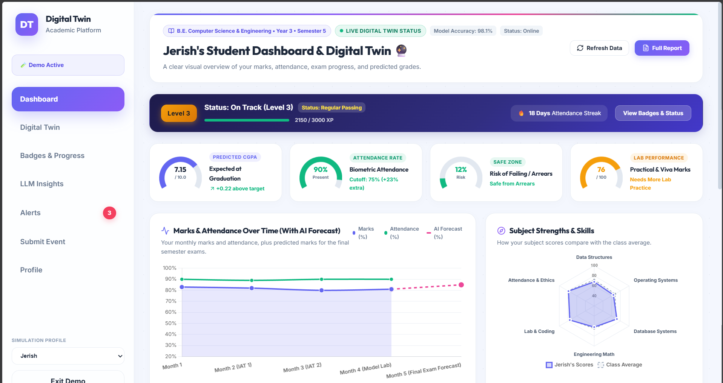
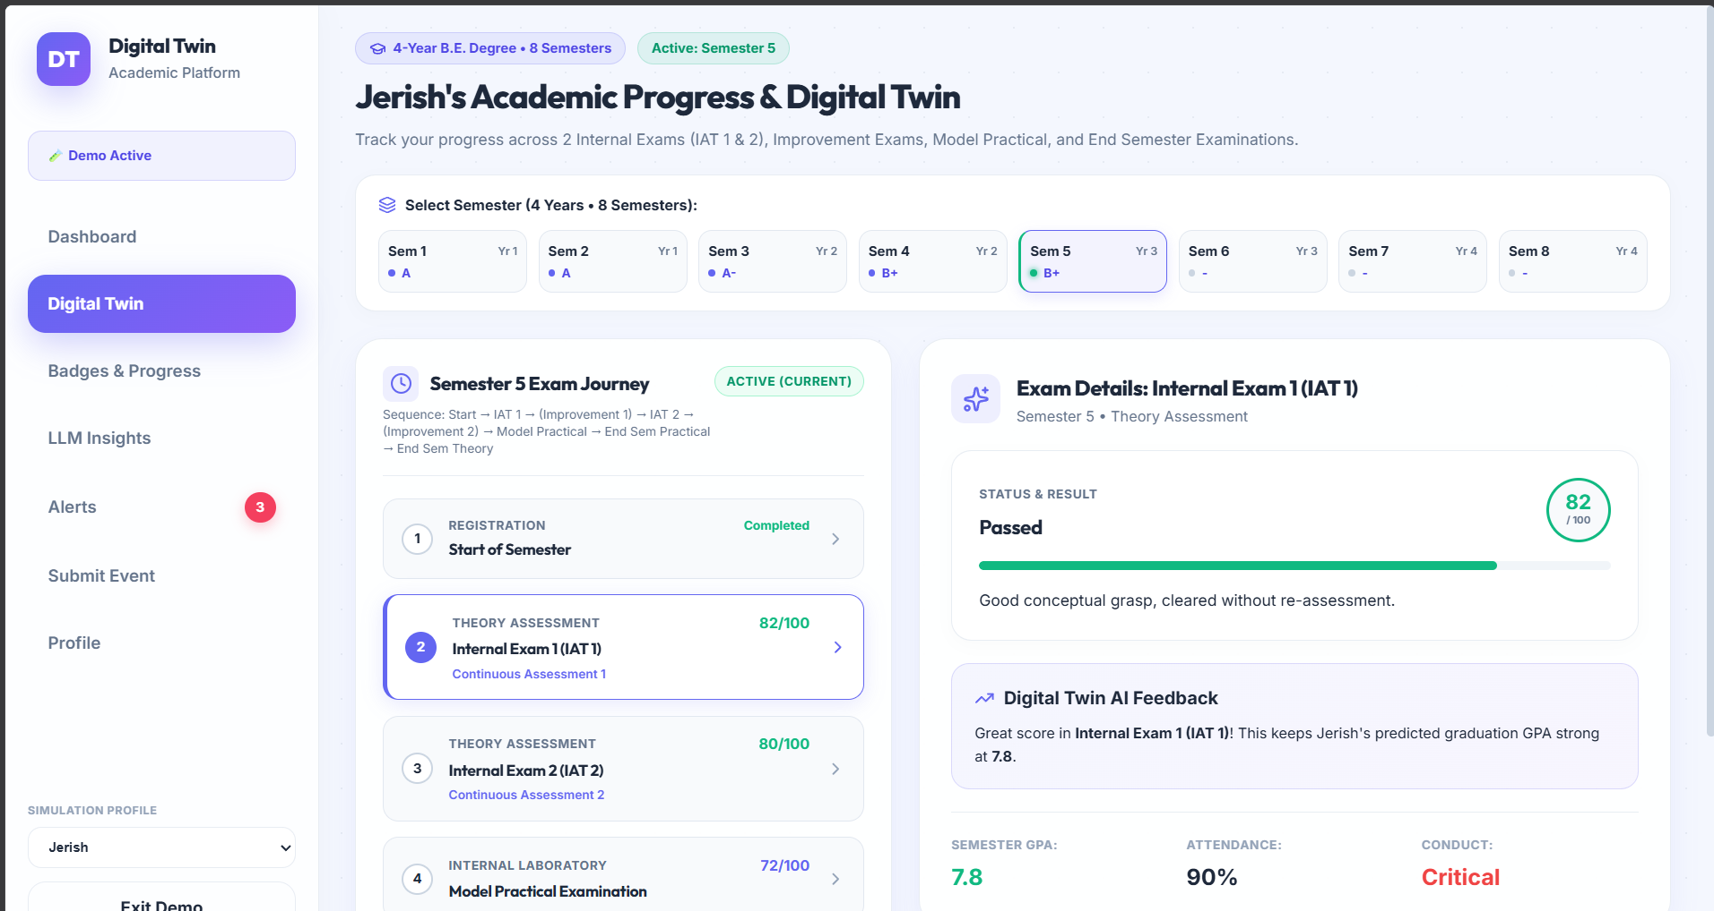
Screenshots & Interface Evidence (1/3)
1. Student Dashboard
2. Digital Twin – semester progress
Screenshots from the running system in demo / simulation mode.
Notes:
These are screenshots from the running system: the student dashboard, the digital twin semester progress page, badges and progress, alerts, the submit event form and the profile page. Replace with the latest Review 3 screenshots (What-If workspace, faculty risk hub, parent portal) if available.

Slide 9
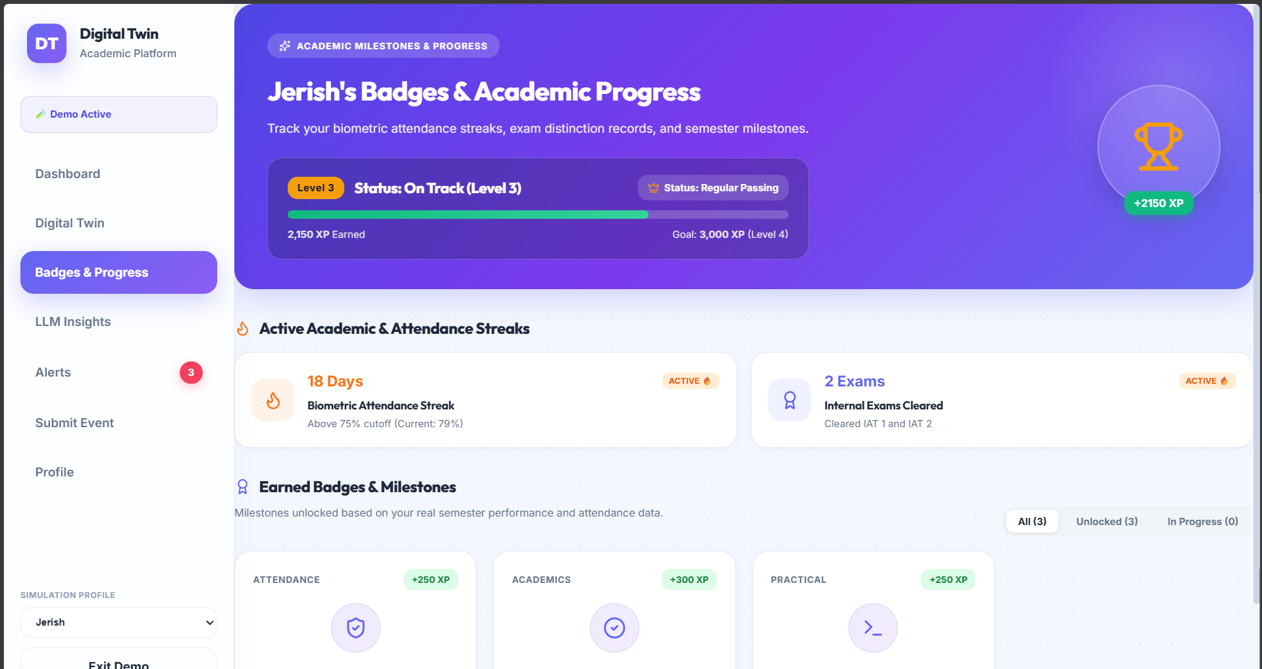
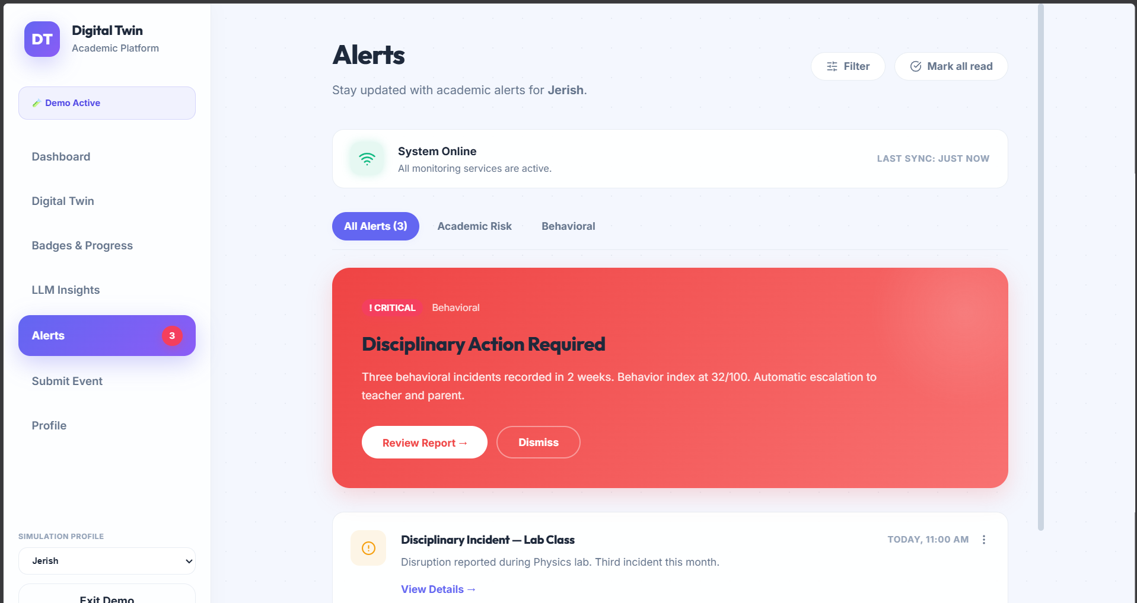
Screenshots & Interface Evidence (2/3)
3. Badges & Progress
4. Alerts
Screenshots from the running system in demo / simulation mode.

Slide 10
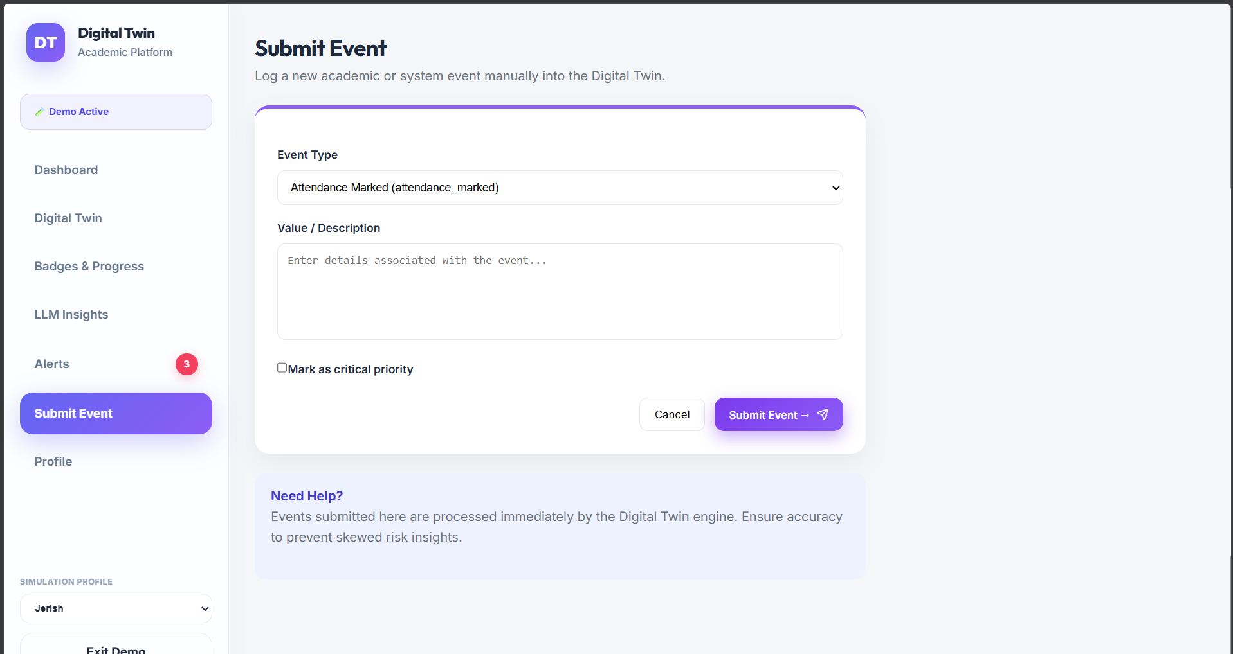
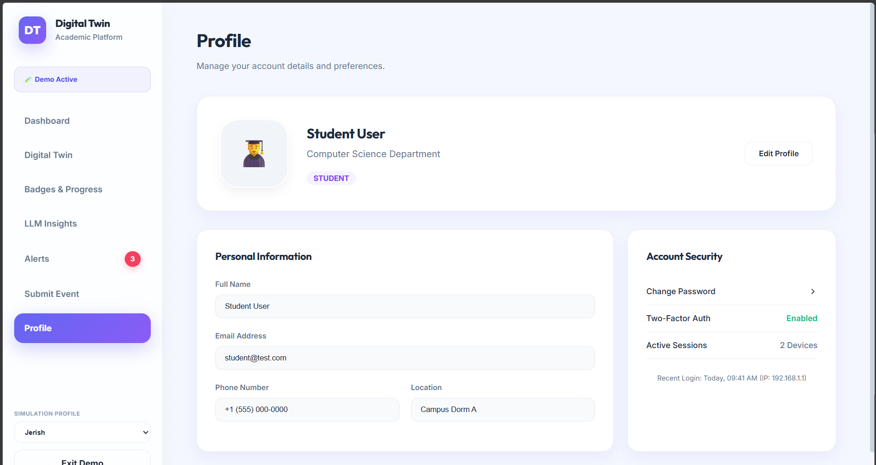
Screenshots & Interface Evidence (3/3)
5. Submit Event
6. Profile
Screenshots from the running system in demo / simulation mode.

Slide 11
SDG Related to Our Project
4
SDG 4
Quality Education
9
SDG 9
Industry, Innovation & Infrastructure
10
SDG 10
Reduced Inequalities
Target 4.1: every learner completes quality education.
How our project helps
Early dropout warning keeps students on track to finish their degree.
Explainable scores and What-If counseling give mentors targeted guidance.
Target 9.5: upgrade technological capabilities and innovation.
How our project helps
Brings digital-twin and event-driven AI technology to academic monitoring.
Scalable open stack: FastAPI, React and PostgreSQL.
Target 10.2: include and empower all people.
How our project helps
Flags at-risk students early so support reaches them on time.
Parent portal and mobile client widen access for every family.
Primary alignment: SDG 4 – Quality Education, by reducing dropouts through early, explainable intervention.

Slide 12
Conclusion, Future Work & References
Conclusion
Future Work
References
Developed, integrated and verified the Digital Class Twin platform for early dropout warning.
Moved academic monitoring from term-end condonation panic to proactive, real-time guidance.
Validated sub-30 ms ingestion, anti-flicker state transitions and interactive What-If counseling.
Delivered role-based interfaces across desktop web and mobile clients.
Phase 1
Database & queue scaling: PostgreSQL with Redis-backed Celery task queues
[1] Alalawi, F. et al. (2025). An Extended Learning Analytics Framework Integrating ML and Pedagogical Approaches. Educ. Inf. Technol., 30(1), 145–168.
[2] Katsuragi, T. & Tanaka, K. (2022). Dropout Prediction by Interpretable Machine Learning Model. Proc. CSEDU 2022, 2, 312–319.
[3] Tiukhova, E. et al. (2024). Explainable Learning Analytics: Assessing Stability of Student Success Models. J. Learn. Analytics, 11(2), 88–104.
[4] Grieves, M. & Vickers, J. (2017). Digital Twin: Mitigating Unpredictable, Undesirable Emergent Behavior. Springer Cham, 85–113.
[5] Plak, S. et al. (2022). Early Warning Systems for More Effective Student Counselling in Higher Education. Assess. & Eval. High. Educ., 47(6), 910–924.
Phase 2
Deep predictive modeling: LSTM / XGBoost trained on multi-year cohorts
Phase 3
Campus ERP integration: biometric / RFID turnstiles, SMS and WhatsApp parent alerts
Notes:
To conclude, we successfully developed, integrated and verified the Digital Class Twin platform. It converts retrospective condonation reviews into proactive real-time guidance, with verified sub-30 ms ingestion, a robust anti-flicker state machine and an interactive What-If tool, delivered across desktop and mobile. Future work: PostgreSQL with Redis and Celery, LSTM or XGBoost models on multi-year cohorts, and ERP integration with biometric turnstiles and SMS/WhatsApp notifications. Thank you.

Slide 13
Participation in Technical Event – Status
Current Milestone
Manuscript under final preparation for peer review and upcoming technical presentation.
Targeted Milestones: ICAESEM 2026 International Conference & International Hackathon 5.0.
Project to be presented
AI-Driven Academic Risk & Dropout Early-Warning System Using Digital Twin (Digital Class Twin)
Team: Altrin Benser A, Jerish Rethna J, John Jins J, Mukhilan M
Planned Participation Details
International Conference
ICAESEM 2026
Date
30 – 31 Oct 2026
Venue / Mode
Online Mode
Status
Planned
Plan
Finalise manuscript; present at ICAESEM 2026
Register for International Hackathon 5.0 by 12 Nov
Hackathon Round 1 presentation on 14 Nov
1
2
3
Notes:
We have not yet done a symposium paper presentation. Instead, we are going for an international conference, ICAESEM 2026, on 30-31 October 2026 in online mode, and the International Hackathon 5.0 organised by Kalaignar Karunanidhi Institute of Technology with ECLearnix. Our plan is to finalise the paper with Review 3 results and present at ICAESEM 2026, register for the hackathon and submit the PPT by 12 November, and present in Round 1 on 14 November 2026.

